Slide 1
DHCP & ARP
Course Code: CSC 3116
Course Title: Computer Networks
Dept. of Computer Science
Faculty of Science and Technology
Lecturer No: | 6 | Week No: | 6 | Semester: | Summer 23-24
Lecturer: | Md. Faruk Abdullah Al Sohan; faruk.sohan@aiub.edu

Slide 2
Lecture Outline
DHCP
What is DHCP?
How DHCP works?
Steps of DHCP
ARP
What is ARP?
How ARP works?
ARP cache timeout
Advantage and Disadvantage

Slide 3
What is DHCP
Dynamic Host Configuration Protocol (DHCP) is a network protocol that enables a server to automatically assign an IP address to a computer from a defined range of numbers configured for a given network.

Slide 4
Bootstrap Protocol
The Bootstrap Protocol (BOOTP) is a computer networking protocol used in Internet Protocol(IP) networks to automatically assign an IP address to network devices from a configuration server.
When a computer that is connected to a network is powered up and boots its operating system, the system software broadcasts BOOTP messages onto the network to request an IP address assignment.
A BOOTP configuration server assigns an IP address based on the request from a pool of addresses configured by an administrator.

Slide 5
Bootstrap Protocol
BOOTP is not a dynamic configuration protocol.
When a client requests its IP address, the BOOTP server consults a table that matches the physical address of the client with its IP address. This implies that the binding between the physical address and the IP address of the client already exists. The binding is predetermined.
However, what if a host moves from one physical network to another?
What if a host wants a temporary IP address?
BOOTP cannot handle these situations because the binding between the physical and IP addresses is static and fixed in a table until changed by the administrator. BOOTP is a static configuration protocol.

Slide 6
DHCP
The Dynamic Host Configuration Protocol (DHCP) has been devised to provide
static and dynamic address allocation that can be manual or automatic.
Static Address Allocation: In this capacity DHCP acts as BOOTP does. It is backward compatible with BOOTP, which means a host running the BOOTP client can request a static address from a DHCP server. A DHCP server has a database that statically binds physical addresses to IP addresses.
Dynamic Address Allocation: DHCP has a second database with a pool of available IP addresses. This second database makes DHCP dynamic. When a DHCP client requests a temporary IP address, the DHCP server goes to the pool of available (unused) IP addresses and assigns an IP address for a negotiable period.

Slide 7
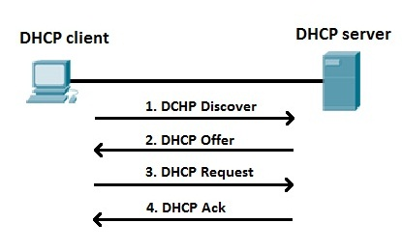
DHCP process explained
Broadcast for DHCP server
Offer an available IP
Client request for it
DHCP server confirmed it

Slide 8
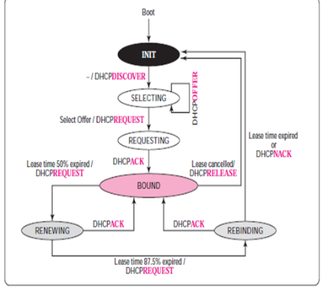
Steps of DHCP: INIT State
When the DHCP client first starts, it is in the INIT state (initializing state).
The client broadcasts a DHCPDISCOVER message using port 67.
DHCPDISCOVER is a request message with the DHCPDISCOVER option.

Slide 9
Steps of DHCP: SELECTING State
After sending the DHCPDISCOVER message, the client goes to the selecting state.
Those servers that can provide this type of service respond with a DHCPOFFER message.
In these messages, the servers offer an IP address. They can also offer the lease duration. The default is 1 hour.
The server that sends a DHCPOFFER locks the offered IP address so that it is not available to any other clients.

Slide 10
Steps of DHCP: SELECTING State (cont.)
The client chooses one of the offers and sends a DHCPREQUEST message to the selected server.
It then goes to the requesting state.
However, if the client receives no DHCPOFFER message, it tries four more times, each with a span of 2 seconds.
If there is no reply to any of these DHCPDISCOVERs, the client sleeps for 5 minutes before trying again.

Slide 11
Steps of DHCP: REQUESTING State
The client remains in the requesting state until it receives a DHCPACK message from the server that creates the binding between the client physical address and its IP address.
After receipt of the DHCPACK, the client goes to the bound state.

Slide 12
Steps of DHCP: BOUND State
In this state, the client can use the IP address until the lease expires.
When 50 percent of the lease period is reached, the client sends another DHCPREQUEST to ask for renewal.
It then goes to the renewing state.
When in the bound state, the client can also cancel the lease and go to the initializing state.

Slide 13
Steps of DHCP: RENEWING State
The client remains in the renewing state until one of two events happens.
It can receive a DHCPACK, which renews the lease agreement.
In this case, the client resets its timer and goes back to the bound state.
Or, if a DHCPACK is not received, and 87.5 percent of the lease time expires, the client goes to the rebinding state.

Slide 14
Steps of DHCP: REBINDING State
The client remains in the rebinding state until one of three events happens.
If the client receives a DHCPNACK or the lease expires, it goes back to the initializing state and tries to get another IP address.
If the client receives a DHCPACK, it goes to the bound state and resets the timer.

Slide 15
DHCP Problem
A Client pc is looking for an ip address. The DHCP server has offered three ip addresses (207.0.0.6/24, LT- 1 hr 14 min), (207.0.0.8/24, LT- 1 hr 28 min), (207.0.0.11/24, LT- 1 hr 32 min). The Client has chosen the 2nd ip address. If the client asks for extended LT of 22 minutes, What is the new timer of RENEWING and REBINDING states?
Again, While calculating timer for REBINDING state, consider the lease time was not extended in RENEWING state. [LT means lease time]

Slide 16
What is ARP?
In networking it is necessary for the sender to know the IP address and the Physical address of the receiver for successful communication. If the MAC address of the receiver is unknown to the sender; it uses Address Resolution Protocol (ARP) protocol to identify the specific MAC address of the receiver.

Slide 17

ARP Request
PC – A PC – B PC- C
IP Add. : 10.0.0.5 IP Add. : 10.0.0.3 IP Add. : 10.0.0.1
MAC Add. MAC Add. MAC Add.
:AA:AA:AA:AA:AA :BB:BB:BB:BB:BB:BB :CC:CC:CC:CC:CC:CC
In the above scenario there are three computers in a single network. PC-A wants to communicate with PC-C. But it only knows the IP address of PC-C. So, PC-A will take the help of ARP to get the MAC address of PC-C.

Slide 18
ARP Request (cont.)
Packet (Network layer):
10.0.0.5 | 10.0.0.1 | I want to know the MAC address of that interface who’s ip address is 10.0.0.1
Frame (Data Link layer):
:AA:AA:AA:AA :AA | FFFF:FFFF:FFFF

Slide 19
ARP Request (cont.)
After making the ARP request frame PC-A will broadcast the frame in the network. Assume that PC-B have got the frame it will read the header of the frame and find out the physical address (FFFF:FFFF:FFFF) as destination MAC address. Which means it’s a broadcast MAC address and the frame is for everyone in that network. Therefore, PC-B will take the frame to the network layer. In the network layer when the destination IP address is checked. There will be a mismatch as PC-B doesn’t hold the ip address 10.0.0.1.

Slide 20
ARP Reply
On the other hand, when PC-C will get the frame, it will read the header of the frame and find out the physical address (FFFF:FFFF:FFFF) as destination address. So, PC-C will transfer it to network layer. In network layer the host will check the destination IP and finds out that it matches with its own IP address. Therefore, PC-C will start reading the content of the packet. And it will make an ARP reply frame and send it back to PC- A.

Slide 21
ARP Reply (cont.)
Packet (Network layer):
10.0.0.1 | 10.0.0.5 | My MAC address is :CC:CC:CC:CC:CC:CC
Frame (Data Link layer):
:CC:CC:CC:CC:CC:CC | :AA:AA:AA:AA :AA

Slide 22
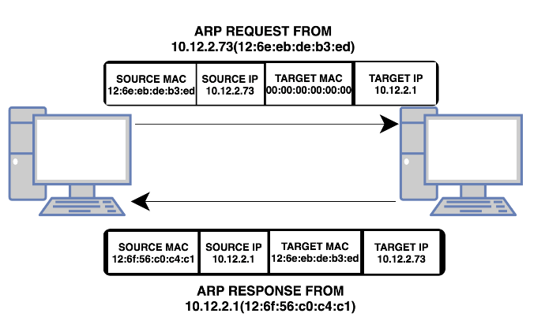
ARP Example

Slide 23
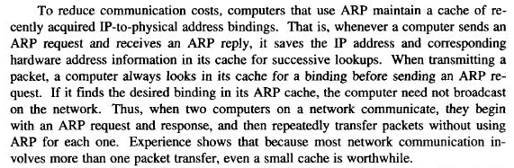
ARP Cache Timeout

Slide 24
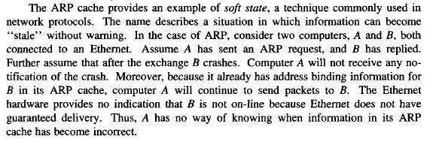
ARP Cache Timeout (cont.)

Slide 25
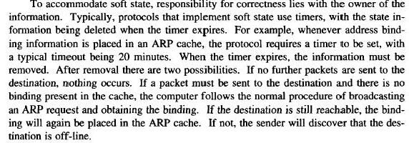
ARP Cache Timeout (cont.)

Slide 26
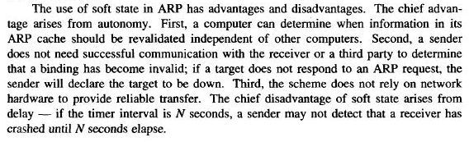
Advantage/Disadvantage

Slide 27
References
Data Communications and Networking, B. A. Forouzan, McGraw-Hill, Inc., Fourth Edition, 2007, USA.
https://www.geeksforgeeks.org/basics-computer-networking/
https://www.tutorialspoint.com/computer_fundamentals/computer_networking.htm

Slide 28
Books
Data Communications and Networking, B. A. Forouzan, McGraw-Hill, Inc., Fourth Edition, 2007, USA.
Computer Networking: A Top-Down Approach, J. F., Kurose, K. W. Ross, Pearson Education, Inc., Sixth Edition, USA.
Official Cert Guide CCNA 200-301 , vol. 1, W. Odom, Cisco Press, First Edition, 2019, USA.
CCNA Routing and Switching, T. Lammle, John Wily & Sons, Second Edition, 2016, USA.
TCP/IP Protocol Suite, B. A. Forouzan, McGraw-Hill, Inc., Fourth Edition, 2009, USA.
Data and Computer Communication, W. Stallings, Pearson Education, Inc., 10th Education, 2013, USA.

